Slide 1

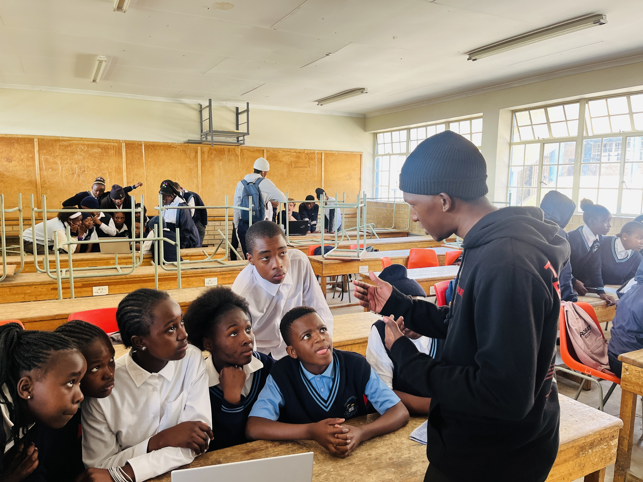




What did I learn about the community

